Slide 1
Pathfinding Algorithms: BFS, A* and Greedy_BFS for Solving Maze
Comparative Study on Maze Solving Algorithms
Krishna Gopal Sharma
S3454618
Artificial Intelligence Foundations
CIS4049

Slide 2
Abstract and Introduction
This project investigates the performance of 3 search algorithms.
The algorithms are:
1. BFS: Explores level by level, guarantees finds the shortest path but explores more nodes.
2. A*: Uses a heuristic to guide search and finds optimal paths. A balances both optimality and exploration efficiency
3. Greedy BFS: Focuses on only heuristic for faster but less optimal results.
50 x 120 maze size.
Algorithms were tested under 3 goal scenarios: (1,1), (49, 2) and (1, 119).

Slide 3
Methodology
The maze was created using the pyamaze library with dimensions 50 x 120.
Three scenarios were defined with varying goal positions:
(1, 1), (49, 2), (1, 119).
Each algorithm was implemented in Python to compare pathfinding efficiency.

Slide 4
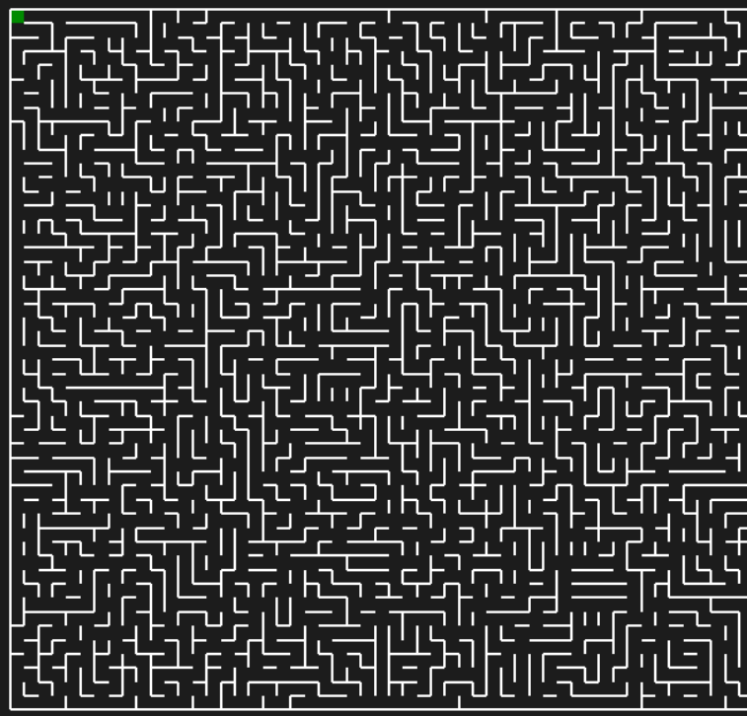
M

Slide 5
M
The

Slide 6
M
The

Slide 7
M
The

Slide 8
M
The

Slide 9
M
The

Slide 10
M
The

Slide 11
Algorithms Overview
1. BFS (Breadth-First Search): Uninformed, exhaustive search.
2. A* Algorithm: Informed search using cost and heuristic (Manhattan Distance).
3. Greedy BFS: Informed search using only heuristic values, faster but less optimal.

Slide 12
Results and Discussion
Key findings from the three scenarios:
Scenario 1 (Goal: 1,1): BFS and A* found optimal path (189 steps), Greedy BFS took 229 steps.
Scenario 2 (Goal: 49,2): BFS and A* found optimal path (174 steps), Greedy BFS took 204 steps.
Scenario 3 (Goal: 1,119): BFS found shortest path (83 steps), Greedy BFS took 101 steps.

Slide 13
Algorithm Comparison
BFS: Guarantees shortest path but explores more nodes.
A*: Balances optimal path with fewer nodes explored.
Greedy BFS: Faster, but sacrifices optimality in some cases.

Slide 14
Achievements and Insights
1. BFS provides optimal paths but at the cost of high exploration.
2. Greedy BFS is faster but not optimal.
3. A* provides a balanced approach, offering optimal paths with efficient exploration.

Slide 15
Conclusion
BFS guarantees the shortest path but is inefficient in terms of exploration.
A* provides a balance between path length and search length.
Greedy BFS offers speed but sacrifices optimality. Future work includes testing advanced heuristics and algorithms.

Slide 16
Future Work
1. Experiment with different heuristics in A* (Euclidean, Manhattan).
2. Compare with advanced algorithms like IDDFS and Dijkstra.
3. Add obstacles and non-uniform costs to increase complexity.

Slide 17

Thank You
Any Questions?

